Slide 1
CS 331
Topic: Advanced File and I/O Operations
MD Romael Haque

Slide 2
Numeric Conversion Functions
C++ 11 provides several to_string(T value) functions to convert a numeric value of type T to string form. Here is a list of a few of the to_string() functions:
string to_string(int value)
string to_string(long value)
string to_string(double value)

Slide 3

Numeric Conversion Functions
The following code fragment illustrates how to use this family of functions. It prints the string

Slide 4

Numeric Conversion Functions
The string-to-numeric conversions are performed by the family of stoX() functions.
The members of this family that perform string conversions to int, long, float, and double are

Slide 5
Numeric Conversion Functions
The first parameter, str, is a string (such as "−342" or "3.48") to be converted to an appropriate numeric form.
These functions will convert to numeric the longest prefix of str possible and return in pos the address of an integer in which to store the index of the first character of str that could not be converted.

Slide 6
Numeric Conversion Functions
The type size_t is defined in the standard library and is commonly used to represent an unsigned integer that is the size of, or an index into, an array, vector, or string.
For example, an attempt to convert the string "−34is even" will succeed and return the integer −34 and set the position of the first character that could not be converted to 3.

Slide 7
Numeric Conversion Functions
The base parameter applies for integral conversions only and indicates the base to be used for the conversion.
The pos and base parameters are optional, so they can be omitted.
If pos is omitted, the index of the stopping character is not stored; and if base is omitted, it is assumed to be 10.
If the string str has an invalid value, such as “is −34 even?", then no conversion can be performed and the function throws an invalid_argument exception

Slide 8
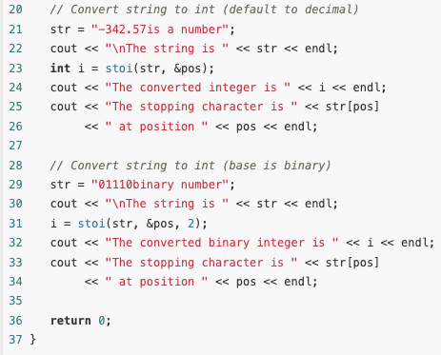
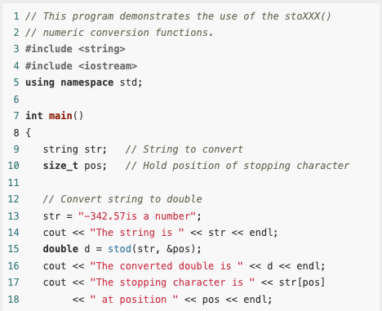
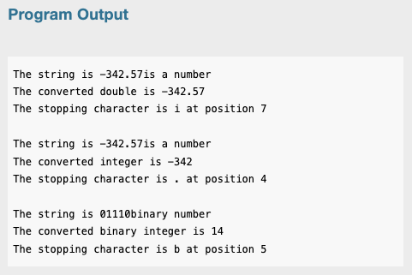
Example

Slide 9
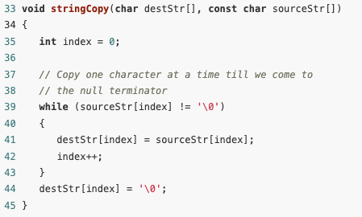
Writing Your Own C-String Handling Functions
You can design your own specialized functions for manipulating strings.
Notice that here the function stringCopy does not accept an argument indicating the size of the arrays.
It simply copies the characters from the source string to the destination until it encounters a null terminator in the source string.
When the null terminator is found, the loop has reached the end of the C-string. =
The last statement in the function assigns a null terminator (the '\0' character) to the end of string2, so it is properly terminated.

Slide 10
Using Pointers to Pass C-String Arguments
Pointers are extremely useful for writing functions that process C-strings.
If the starting address of a string is passed into a pointer parameter variable, it can be assumed that all the characters, from that address up to the byte that holds the null terminator are part of the string.
So, it isn’t necessary to know the length of the array that holds the string.)

Slide 11
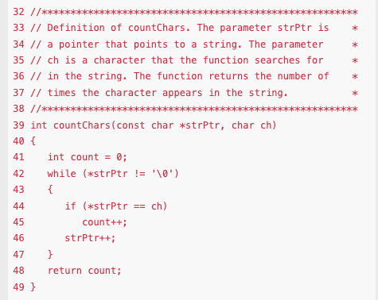
Using Pointers to Pass C-String Arguments
In the function countChars, strPtr points to the C-string that is to be searched and ch contains the character to look for.
The while loop repeats as long the character strPtr points to is not the null terminator

Slide 12
Using Pointers to Pass C-String Arguments
Inside the loop, the following if statement compares the character that strPtr points to with the character in ch: if (*strPtr == ch)
If the two are equal, the variable count is incremented. (count keeps a running total of the number of times the character appears.)

Slide 13
Using Pointers to Pass C-String Arguments
The last statement in the loop is strPtr++;
This statement increments the address in strPtr.
This causes strPtr to point to the next character in the string.
Then the loop starts over. When strPtr finally reaches the null terminator, the loop terminates and the function returns the value in count.

Slide 14
Input and Output Streams
An input stream is a sequence from which data can be read; an output stream is a sequence to which data can be written; and an input–output stream is a sequence of data that allows both reading and writing.
The keyboard is the standard example of an input stream, and the monitor screen is the standard example of an output stream.

Slide 15
The File Stream Classes
C++ provides various classes for working with streams.
These include
istream and ostream for standard input and output;
ifstream, ofstream, and fstream for file IO;
istringstream and ostringstream for reading and writing strings.
To read from the keyboard, you use cin, which is a predefined object of the istream class. To write to the screen, you use cout, a predefined object of the ostream class
In this lecture, we will talk about ifstream, ofstream, and fstream for file IO.

Slide 16

The File Stream Classes
The ifstream, ofstream, and fstream classes are very similar.
Each has a default constructor that allows instances of the class to be created:
In addition, each has initialization constructors that take two parameters: the name of a file to be opened and an open mode.
The name of the file is given by a C-string.
The open mode is a setting that determines how the file will be used.

Slide 17
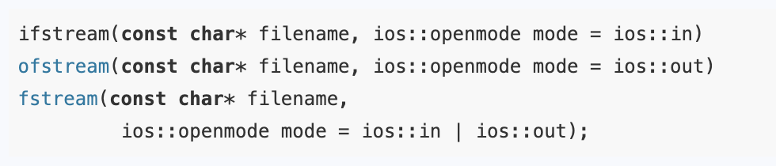
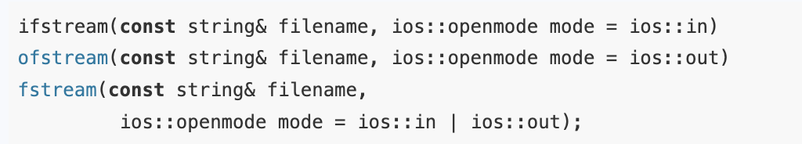
The File Stream Classes
The initialization constructors have the following prototypes:
With C++11, you can use a string object for the filename:

Slide 18
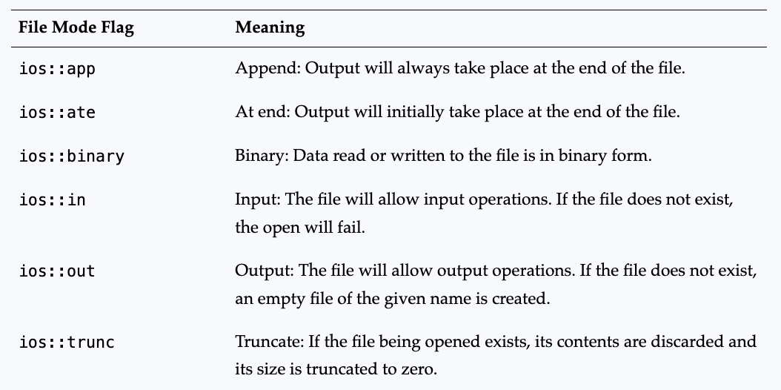
The File Stream Classes
The open mode parameter is optional.
When not specified, the open mode defaults to the values shown in the initialization constructors.
The meaning of these open mode values and others like them is explained in the table

Slide 19
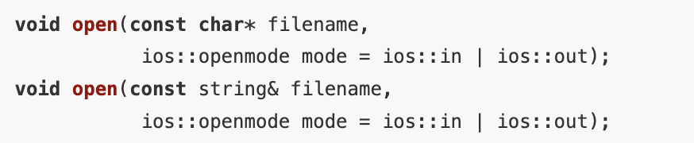
The File Stream Classes
All three file stream classes have member functions with parameters similar to those of the initialization constructors that can be used to open files.
For example, the open functions for fstream have the following prototypes:
Each of these classes also has a close member function that is used to sever the connection when the program is done using the file: void close();

Slide 20
The File Stream Classes
Open files use resources in the operating system, so it is important to close files as soon as you are done using them.
Also, data that your program writes to the file stream object is often buffered within the operating system and is not immediately written to disk.
When you close the file, the operating system writes this data to the disk in a process known as flushing the buffer.
Closing the file will ensure that buffered data is not lost in the event of a power failure or some other circumstances that causes your program to terminate abnormally.

Slide 21
The File Stream Classes
The fstream class combines in itself the capabilities of both ifstream and ofstream.
Therefore, fstream has every member function and operator possessed by those two classes.
In particular, you can use the extraction operator >> and the insertion operator << to read and write data on fstream objects.
By default, ifstream objects open files for input, ofstream objects open files for output, and fstream objects open files for both input and output.

Slide 22
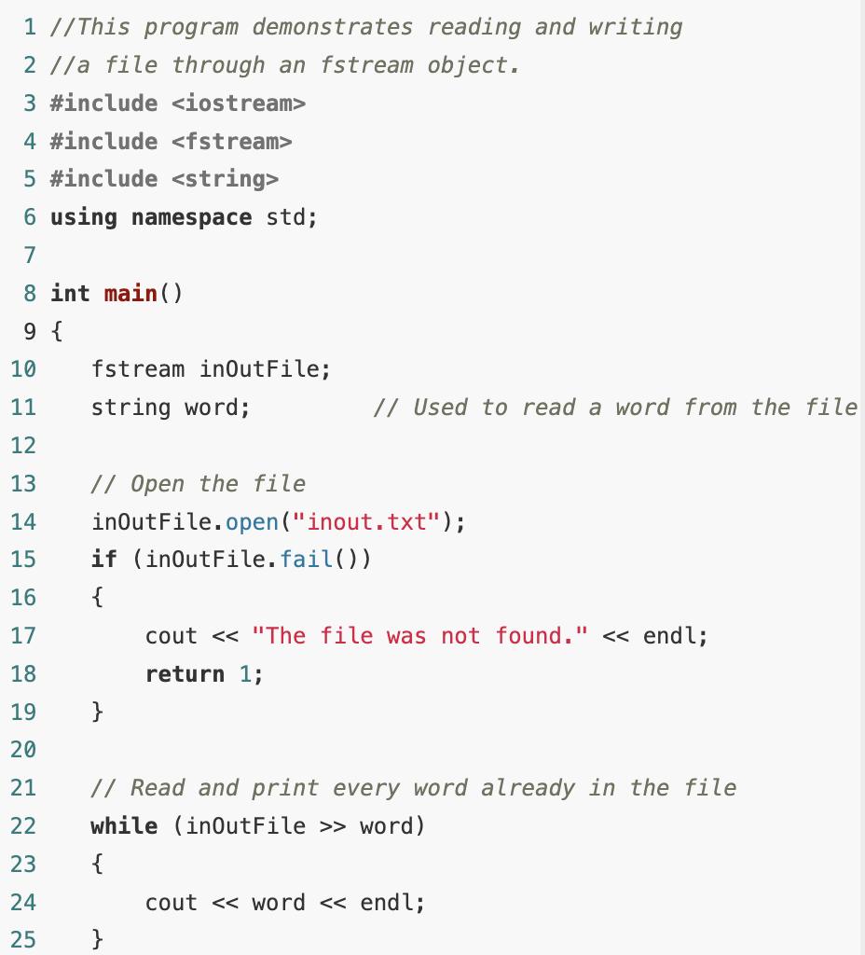
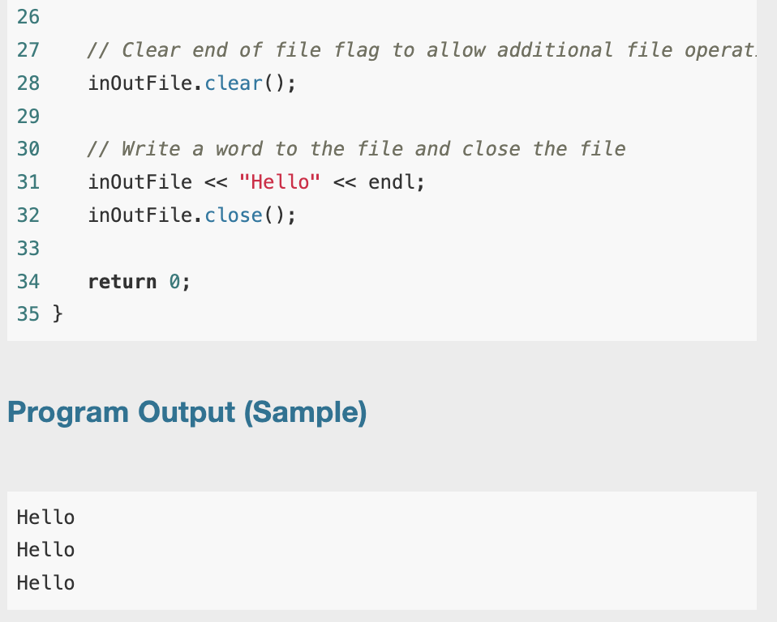
Example
Notes:
gives a simple (albeit not very useful) example of using an fstream object to open a file for both reading and writing. It opens the file, reads and prints its contents, and then writes the word “Hello” at the end of the file. If you start with an empty file named “inout.txt,” repeated execution of this program will result in the word “Hello” being added to the file each time the program is run.

Slide 23
The File Stream Classes
The loop of lines 22–25 terminates only when the extraction operator fails to read the next word at the end of the file.
File stream objects set a number of error flags whenever an input or output operation fails.
Once an error flag is set, the stream will not allow further operations to be performed on it until the error flags have been cleared.
The call to the clear function in line 28 clears these flags, allowing the statements in lines 31 and 32 to succeed.

Slide 24
File Open Modes
A file open mode is a setting that determines how the file can be used.
The type openmode is defined in a stream-related class called ios.
Values of this type are static constant members of the ios class.
Each such value represents a flag or an option that can be set when the file is opened.

Slide 25

File Open Modes
The binary or operator | can be used to combine the effect of two or more flags.
For example, the open mode causes the file to be opened for both input and output, with output initially taking place at the end of the file.

Slide 26
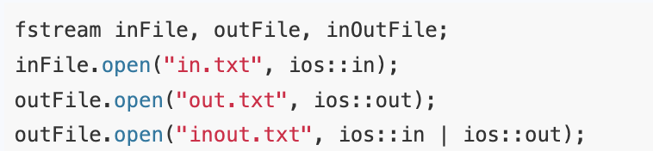
File Open Modes
Here is an example of opening three files for input, output, and input-output using fstream:

Slide 27
File Open Modes
When used by itself, the ios::out flag causes the contents of an existing file to be deleted, the assumption being that the programmer wants to overwrite the file.
If ios::out is combined with ios::app, the contents of the existing file are preserved, and all new data is appended to the end of the file.

Slide 28

Using Constructors to Open Files
Using one of the initialization constructors, you can create a stream object and open a file in a single statement:

Slide 29
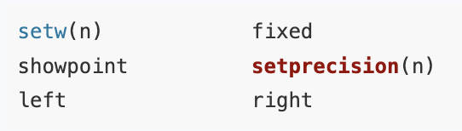
Output Formatting and I/O Manipulators
The I/O manipulators you learned about before can be used on stream objects.
Such as these manipulators can be used on fstream, ofstream, and ostringstream objects
.

Slide 30
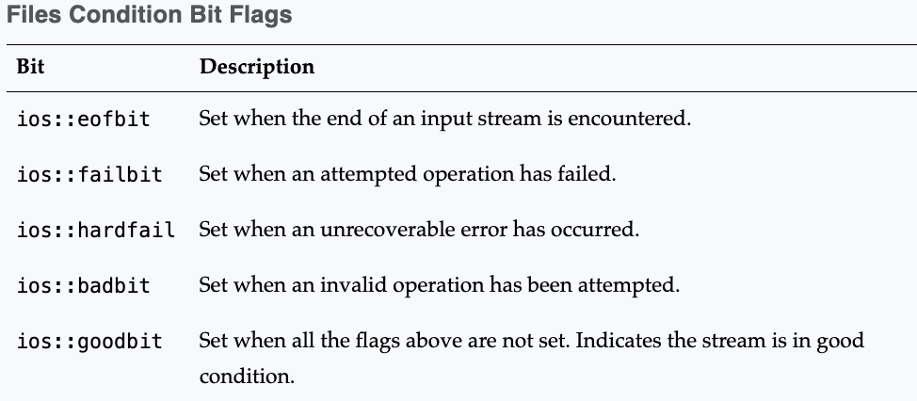
More Detailed Error Testing
All stream objects contain a set of bits that act as flags.
These flags indicate the current state of the stream

Slide 31
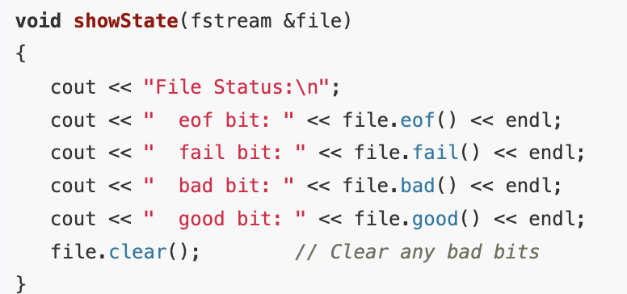
More Detailed Error Testing: Example
The function showState, shown here, accepts a file stream reference as its argument.
It shows the state of the file by displaying the return values of the eof(), fail(), bad(), and good() member functions.

Slide 32
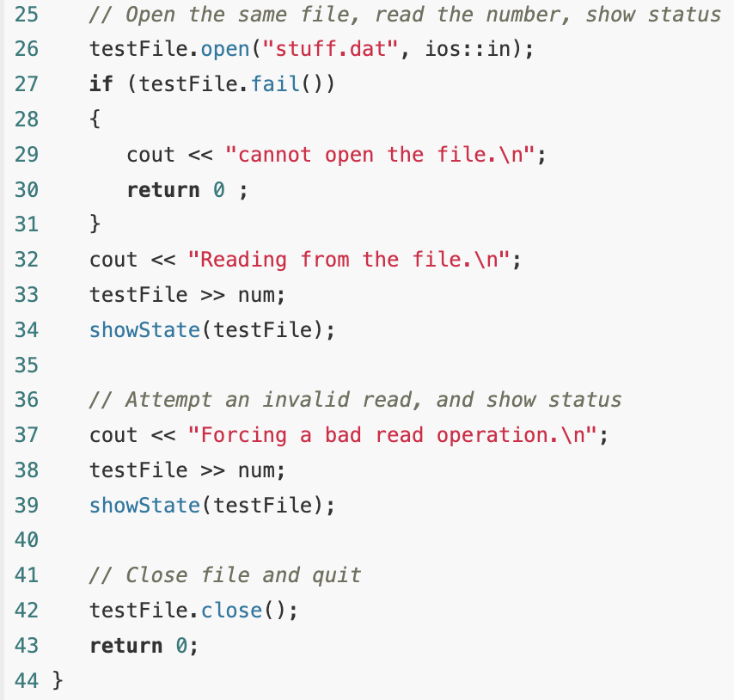
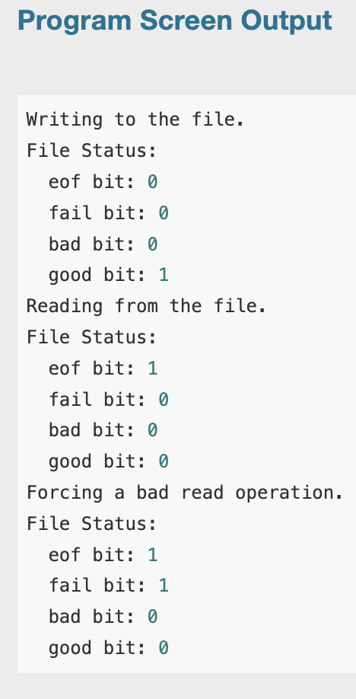
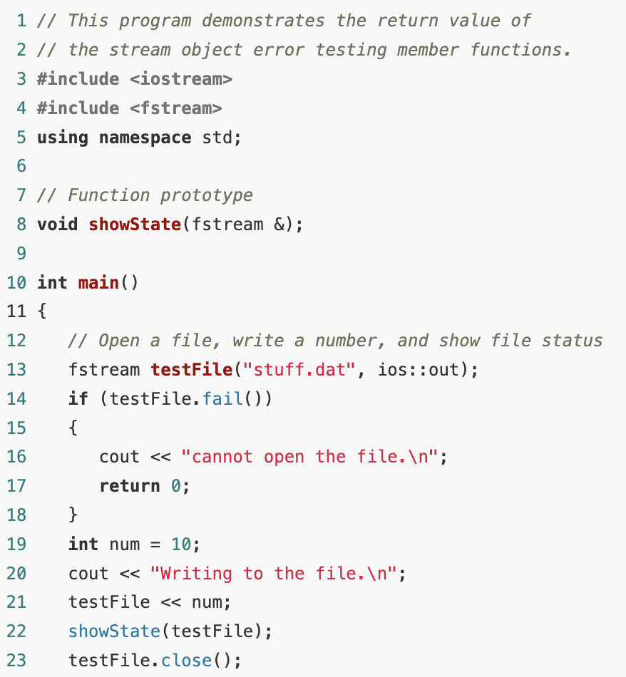
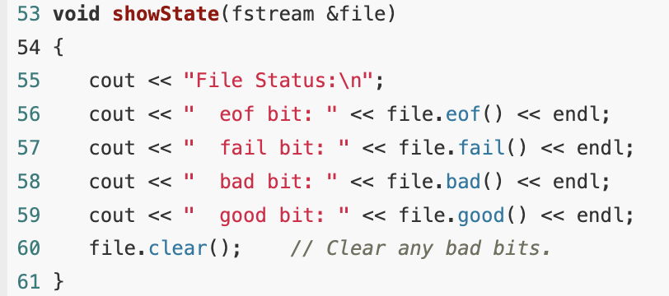
The main() function

Slide 33
Member Functions for Reading and Writing Files
File stream objects have member functions for more specialized file reading and writing.
If whitespace characters are part of the information in a file, a problem arises when the file is read by the >> operator.
Since the operator considers whitespace characters as delimiters, it does not read them.

Slide 34
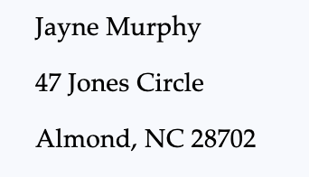
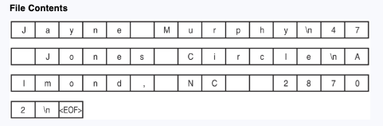
Member Functions for Reading and Writing Files
For example, consider the file murphy.txt that contains the following information:
The following figure shows the way the information is recorded in the file.

Slide 35
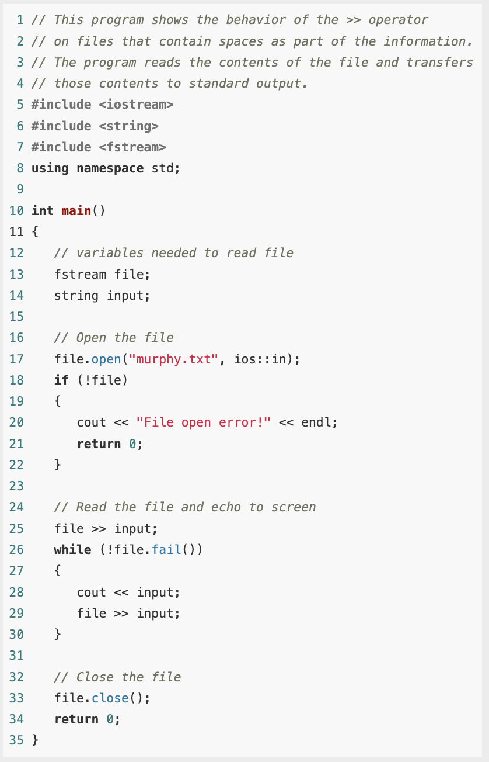

Member Functions for Reading and Writing Files
The problem that arises from use of the >> operator is evident in the output of this example

Slide 36
The getline function
One way to get around the problem in previous example is to use a function that reads an entire line of text.
There is a global function that is part of the string library that you can use for this purpose:

Slide 37
The getline function
This function reads a line of text from a stream is and stores it into a string variable str.
The function has an optional parameter delim that marks the end of the line to be read.
The delimiting character is removed from the stream and discarded.
If getline is called without the third parameter, the delimiter is assumed to be the end of line character '\n'.

Slide 38
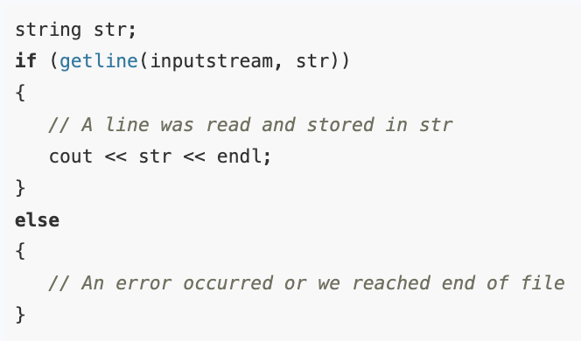
The getline function
The first parameter, is, must be an object of the class istream.
It can also be any object of the classes istringstream, ifstream, or fstream (if an fstream object is passed, it must have been opened for input).
The value returned is a reference to the input stream that was just read.
This allows the return value to be tested to ascertain the success or failure of the call as in this code fragment:

Slide 39
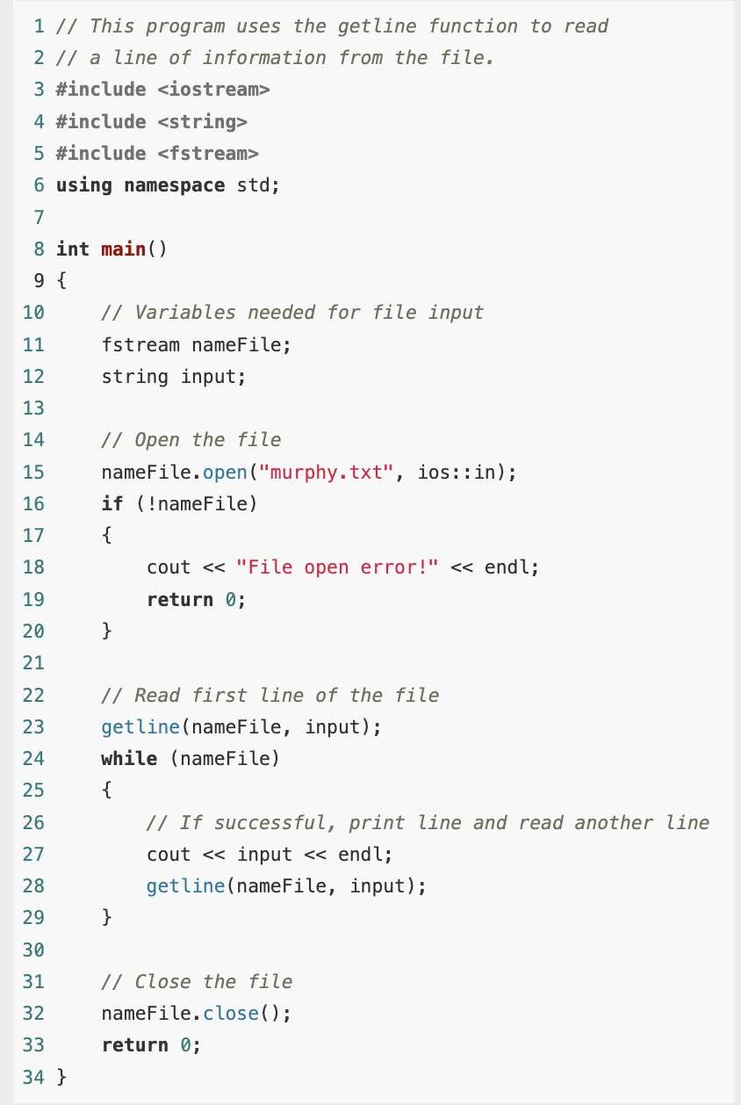
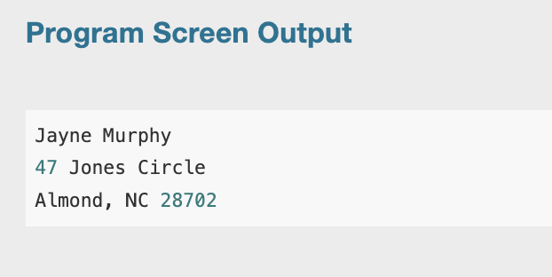
Example

Slide 40

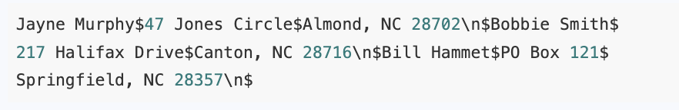
The getline function
Because the third argument of the getline function was left out in previous example, its default value is \n.
Sometimes you might want to specify another delimiter.
For example, consider a file that contains multiple names and addresses internally formatted in the following manner:

Slide 41
The getline function
Think of this file as consisting of three records.
A record is a complete set of information about a single item.
Also, the records in the file are made of three fields.
The first field is the person’s name.
The second field is the person’s street address or PO box number.
The third field contains the person’s city, state, and ZIP code.
Notice that each field ends with a $ character, and each record ends with a \n character.

Slide 42
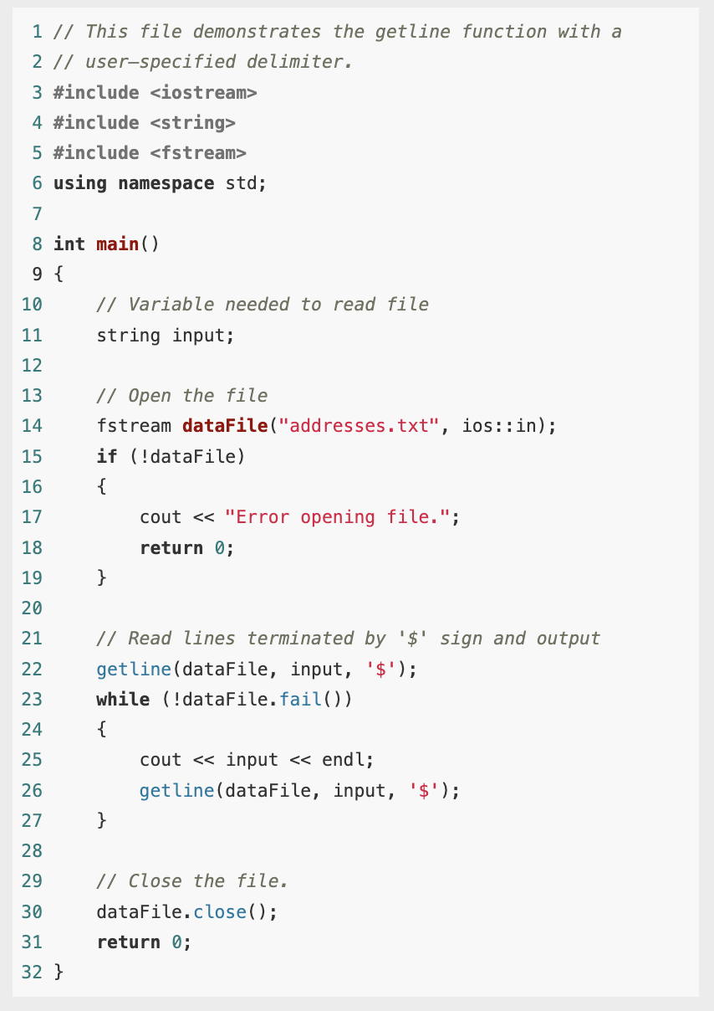
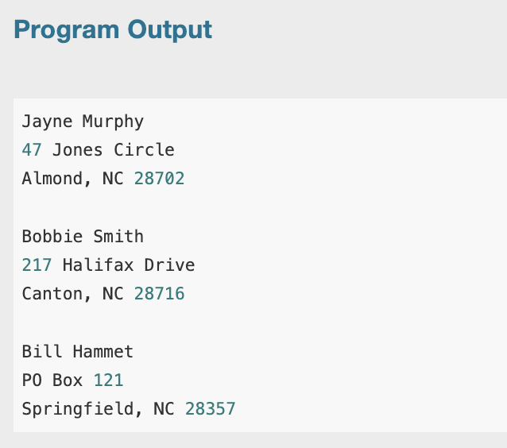
The getline function
In this example we used getline function to detect the $ characters.

Slide 43
The getline function
Notice that the \n characters, which mark the end of each record, are also part of the output.
They cause an extra blank line to be printed on the screen, separating the records.
When using a printable character such as $ to delimit information in a file, be sure to select a character that will not actually appear in the information itself.
Since it’s doubtful that anyone’s name or address contains a $ character, it’s an acceptable delimiter.
If the file contained dollar amounts, however, another delimiter would have been chosen.

Slide 44

The get Family of Member Functions
Each of the input classes ifstream , fstream , and istringstream has a family of get member functions that can be used to read single characters:
The first version reads a single character.
If successful, it returns an integer code representing the character that was read.
If unsuccessful, it sets the error codes on the stream and returns the special value EOF

Slide 45
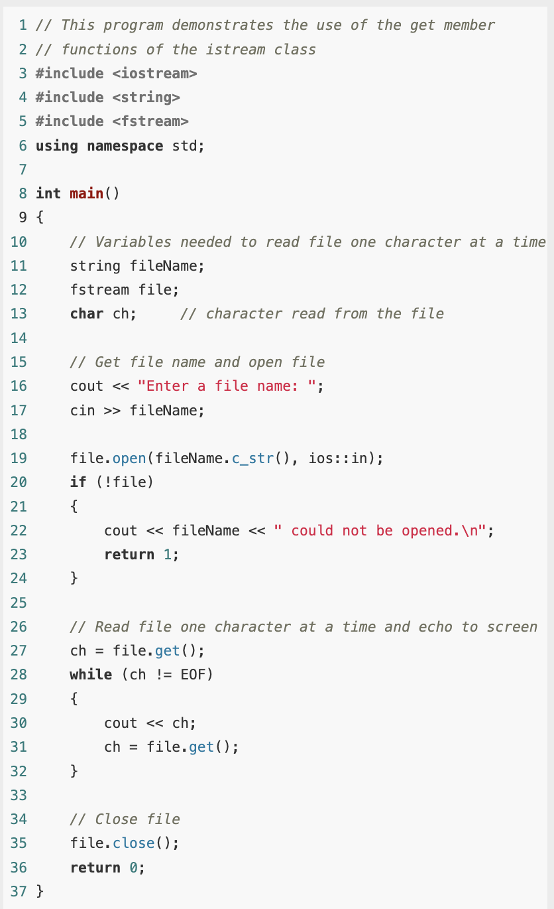
Example
This program will display the contents of any file.
Because the get function does not skip whitespaces, all the characters will be shown exactly as they appear in the file.

Slide 46
The peek Member Function
The peek member function is similar to get, but there is an important difference.
When the get function is called, it returns the next character available from the input stream and removes that character from the stream.
In contrast, the peek function returns a copy of the next character available without removing it from the stream.
Thus, get()reads a character from the file, but peek() just “looks” at the next character without actually reading it.

Slide 47
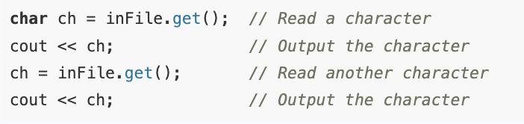
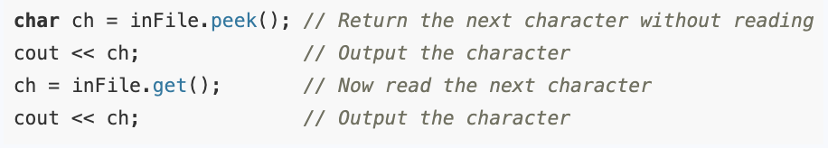
The peek Member Function
To see the difference, suppose that a newly opened file contains the string "abc".
Then the sequence of statements will print the two characters "ab" on the screen.
However, the statements will print the two characters "aa" on the screen.

Slide 48
The peek Member Function
The peek function is useful when you need to know what kind of data you are about to read before you actually read it, so you can decide on the best input method to use.
If the data is numeric, it is best read with the stream extraction operator >>, but if the data is a non-numeric sequence of characters, then it should be read with get or getline.

Slide 49
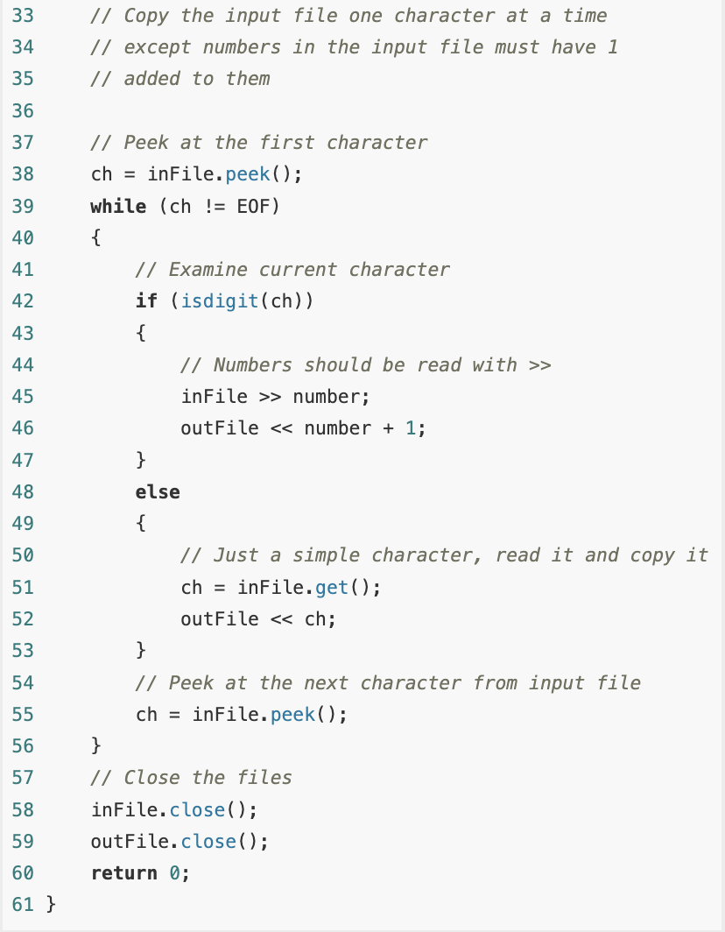
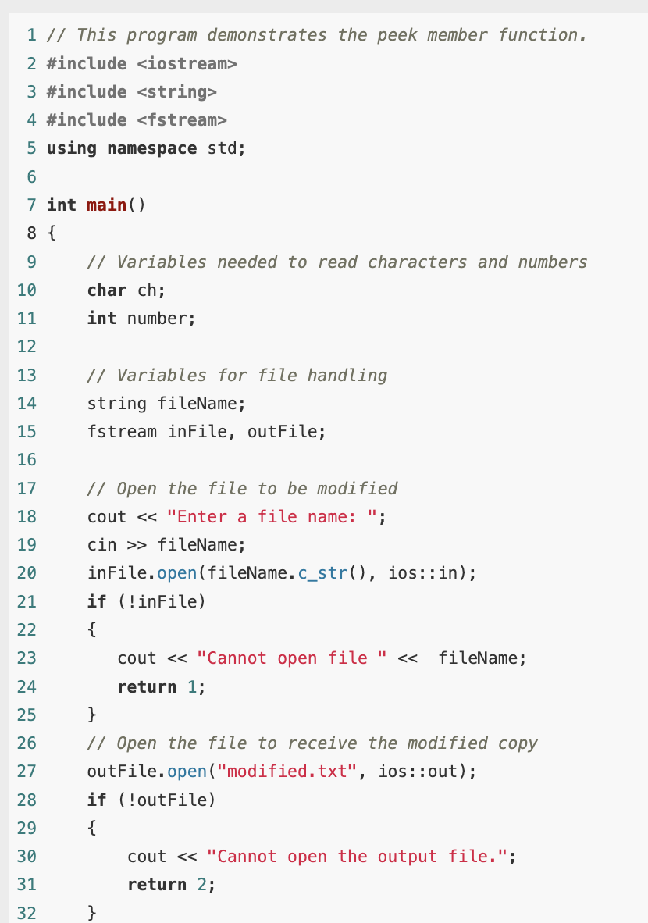
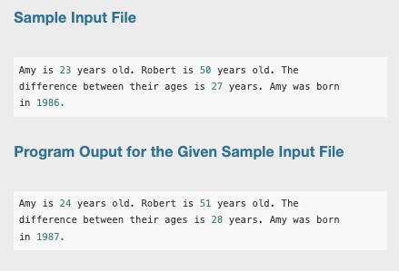
Example

Slide 50
The peek Member Function
The program cannot tell beforehand whether the next character to be read is a digit that starts a number (in which case the entire number should be read using the stream extraction operator >>) or just an ordinary nondigit character (in which case the character should be read using a call to the get() member function).
The program therefore uses peek() to examine characters without actually reading them (lines 38 and 55).
If a character is a digit, the extraction operator is called to read the number that starts with that character (lines 44–46).
Otherwise, the character is read using a call to get() (lines 50–52) and copied to the target file.

Slide 51
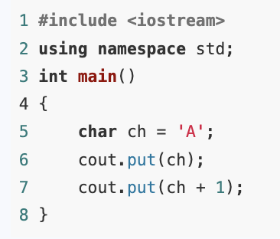
The put Member Function
Each of the output stream classes ofstream, fstream, and ostringstream has a member function that takes the integer code of a character and writes the corresponding character to the stream.
ostream& put(int c);
You can think of put as the output stream counterpart to the input stream get functions.
As an example, the following simple program prints AB on the screen.

Slide 52
Rewinding a File
Many times it is useful to open a file, process all the data in it, rewind the file back to the beginning, and process it again, perhaps in a slightly different fashion.
For example, a user may ask the program to search a database for all records of a certain kind, and when those are found, the user may want to search the database for all records of some other kind.
File stream classes offer a number of different member functions that can be used to move around in a file.

Slide 53
Rewinding a File
One such method is the member function of the input stream classes (the file “seeks” to a certain place in the file; the ‘g’ is for “get” and denotes that the function works on an input stream, because we “get” data from an input stream).
seekg(offset, place);

Slide 54
Rewinding a File
seekg(offset, place);
The new location in the file to seek to is given by the two parameters: the new location is at an offset of offset bytes from the starting point given by place.
The offset parameter is a long integer, while place can be one of three values defined in the ios class.
The starting place may be the beginning of the file, the current place in the file, or the end of the file.
These places are indicated by the constants ios:beg, ios::cur, and ios::end, respectively.

Slide 55

Rewinding a File
To move to the beginning of a file, use the call to move 0 bytes relative to the beginning of the file.
seekg(0L, ios::beg);
If you are already at the end of the file, you must clear the end of file flag before calling this function.
Thus, to move to the beginning of a file stream dataIn that you have just read to the end, you need the two statements

Slide 56
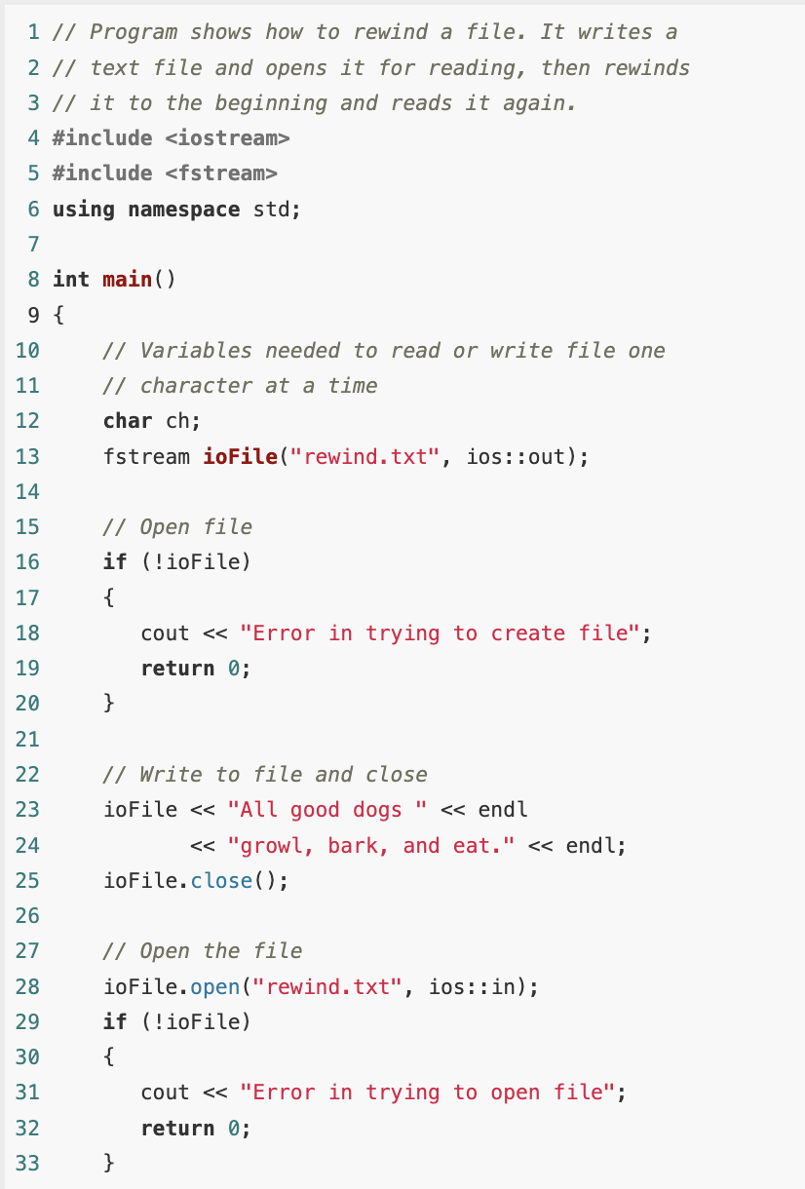
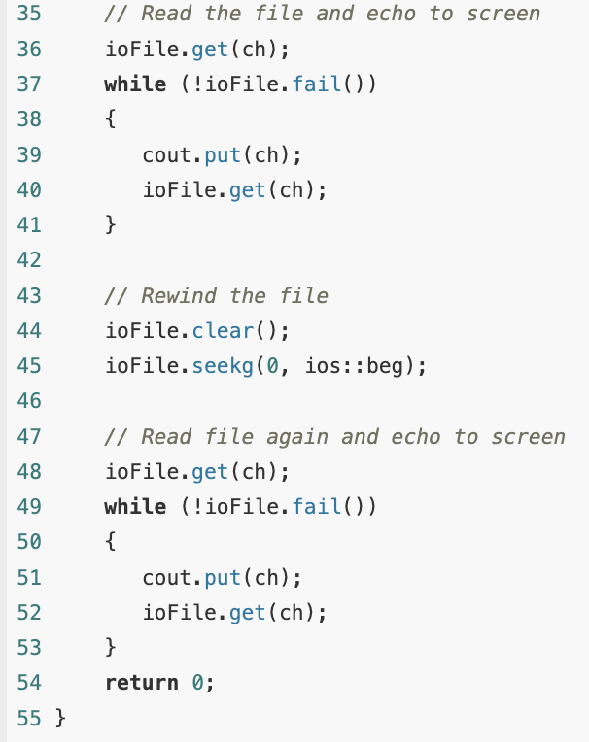
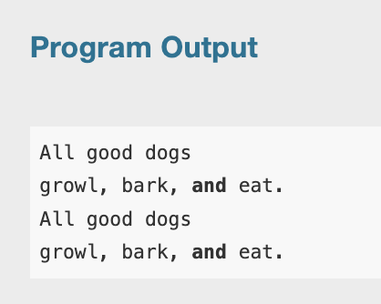
Example

